Slide 1
運用優先權與無耐性之區塊鏈交易模型研究 A Study on Blockchain Transaction Models with Priority and Impatience
指導教授： 鍾順平 教授
研 究 生： 蔡怡翔
西元 2025 年 7 月 2 日

Slide 2
Outline
Motivation
System Model
Analytical Model
Numerical Results
Conclusions and Future Works
Notes:
動機
系統模型
解析模型
數值結果
結論 未來展望

Slide 3
Outline
Motivation
System Model
Analytical Model
Numerical Results
Conclusions and Future Works
Notes:
動機

Slide 4
Motivation
Blockchain is first proposed by Nakamoto in 2008; evolved into core infrastructure for digital trust and decentralized systems
Decentralization, transparency, and immutability
Key technical challenge: interoperability
Difficulty in communication and asset exchange between independent blockchains
Solution: cross-chain bridges
Protocol-base mechanism which allow heterogeneous blockchains to interoperate
Notes:
區塊鏈技術暨2008年由中本聰撰寫的比特幣白皮書中首次出現其觀念。
區塊鏈作為分散是帳本技術的一種，近幾年在除了彼特幣以外，也在能源、金融等領域中發展成為數位信任和去中心化系統的核心基礎
他的去中心化、透明化、和不變性保障了使用者的資料更加可靠及安
而當今區塊鏈最迫切的技術挑戰之一為「互通性」
也就是獨立運營的區塊鏈網路之間能夠溝通和交換資訊的技術。
這項挑戰催生了跨連橋(cross chain bridges)的發展。
跨鏈橋不是實體存在的橋樑，而是由一組設計良好的協議構成的機制，能夠讓不同技術架構的區塊鏈彼此連接與互通。

Slide 5
Motivation
In [2], apply M/M/n/L queues modeling transaction processing and block generation in Bitcoin
Queue length / block generation rate
In [7], Blockchain queuing model with non-preemptive limited-priority is proposed, illustrating the performance tradeoffs between high- and low-priority transaction classes
In [9]~[10], a cross-chain transaction system that realizes multi-chain interoperability and provides a practical cross-chain architecture is presented.
Notes:
參考文獻2中，採用M/M/n/L排隊模型模擬彼特幣區塊鏈的挖礦流程，並觀察在固定的佇列容量與block generation rate下的系統效能表現
接下來、在參考文獻7中提出一種非搶先優先權的區塊鏈交易排隊模型，讓在礦工資源有限的狀況下，高優先權與低優先權之間的交易權衡
最後，在參考文獻10中，他們提出了有效的跨鏈系統分析模型，實現多鏈互通，提供了實務跨鏈架構的跨鏈傳輸系統

Slide 6
Motivation
The partial batch queueing model for cross-chain transaction flows is studied
Two sequential queues: customer queue and block queue
Customer queue: waiting to be selected for block formation
Block queue: undergoing consensus
ON / OFF mechanism
Four scenarios are considered
Non-preemptive priority (single-class / two-class)
With / Without impatience
Notes:
本論文前面提到的引言和議題，發展了一個跨鏈交易流程的partial batch(部分批次)排隊模型
系統中有兩個串連的queue，第一個是customer queue，顧客進入系統中會首先在這個queue中等待被打包成為一個block
第二個queue是block queue，當顧客被打包進block queue後會在這裡面進行consensus(共識)，consensus結束之後即離開系統
那我們的系統中還有加入一個ON/OFF開關機制，這是為了模擬現實生活中可能會遇到的駭客行為或是環境因素所導致的連線失敗等狀況，在OFF的期間block generation和consensus行為都會暫停。
我們提出了四種scenarios，分別組合有無non-preemptive priority，與有沒有impatience行為的影響

Slide 7
Outline
Motivation
System Model
Analytical Model
Numerical Results
Conclusions and Future Works
Notes:
系統模型

Slide 8
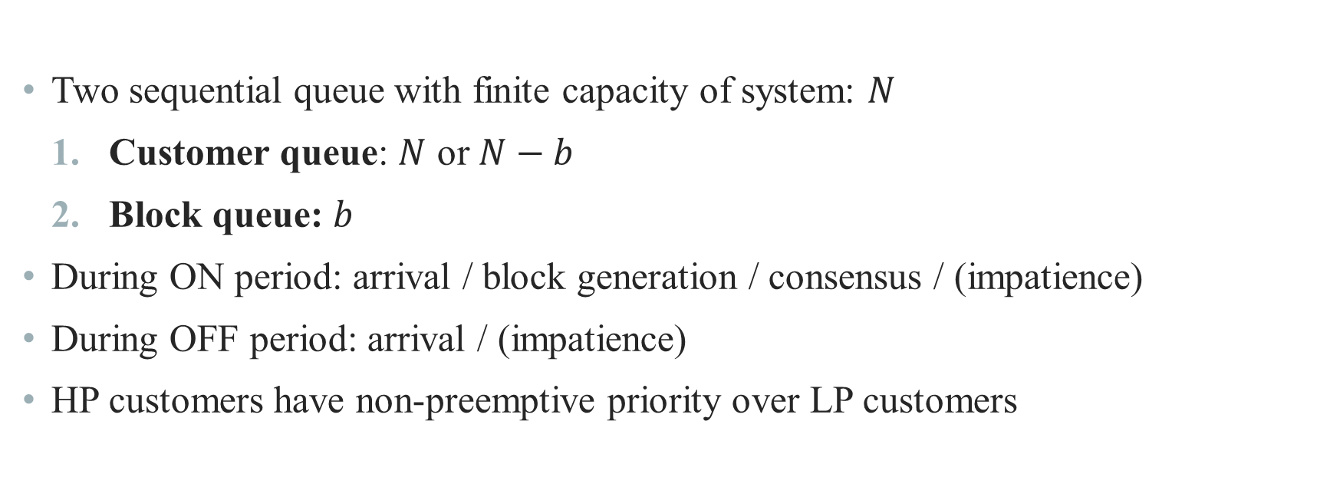
System Model
Two sequential queue with finite capacity of system: $N$
Customer queue: $N$ or $N−b$
Block queue: $b$
During ON period: arrival / block generation / consensus / (impatience)
During OFF period: arrival / (impatience)
HP customers have non-preemptive priority over LP customers
Notes:
這邊是關於系統容量，queue的容量，ON/OFF機制，與高低優先權的關係等說明的簡單的文字介紹，接下來會用圖例詳細說明

Slide 9
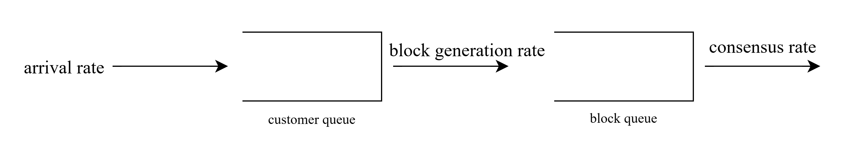



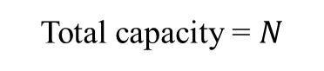
System Model
ON
OFF
Total capacity = $N$
OFF
OFF
(impatient rate)
$$N$$
num in block queue = 0
$$N−b$$
$$0\sim b$$
num in block queue > 0
9
Notes:
系統容量介紹
加入impatience的介紹
ON period
OFF period

Slide 10
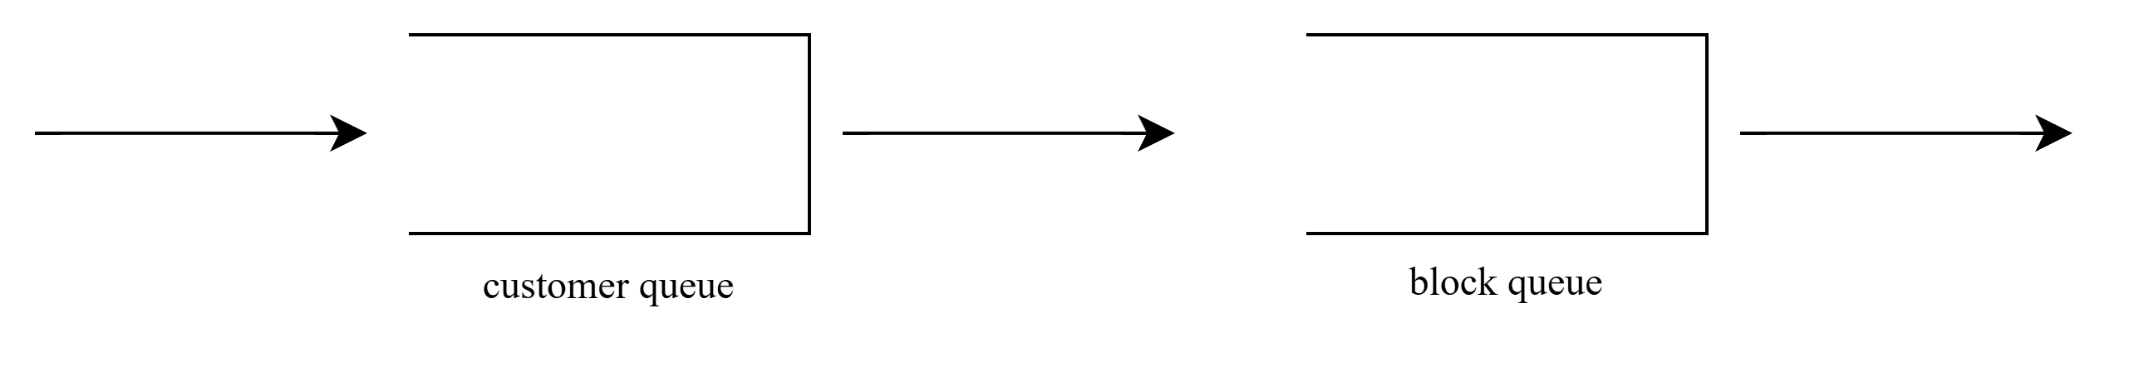
System Model – Scenario 1
Arrival rate
2
1
Block generation rate
block
Consensus rate
Notes:
Single-class without impatience

Slide 11

System Model – Scenario 2
(Non-preemptive)
HP arrival rate
L
H
HP block generation rate
block
HP consensus rate
L
LP arrival rate
LP block generation rate
LP consensus rate
Notes:
Two-class without impatience

Slide 12
System Model – Scenario 3
Arrival rate
2
1
Block generation rate
block
Consensus rate
LP / HP impatient rate
Notes:
Single-class with impatience

Slide 13
System Model – Scenario 4
(Non-preemptive)
HP arrival rate
L
H
HP block generation rate
block
HP consensus rate
L
LP arrival rate
LP block generation rate
LP consensus rate
LP / HP impatient rate
Notes:
two-class with impatience

Slide 14
Outline
Motivation
System Model
Analytical Model
Numerical Results
Conclusions and Future Works
Notes:
解析模型

Slide 15
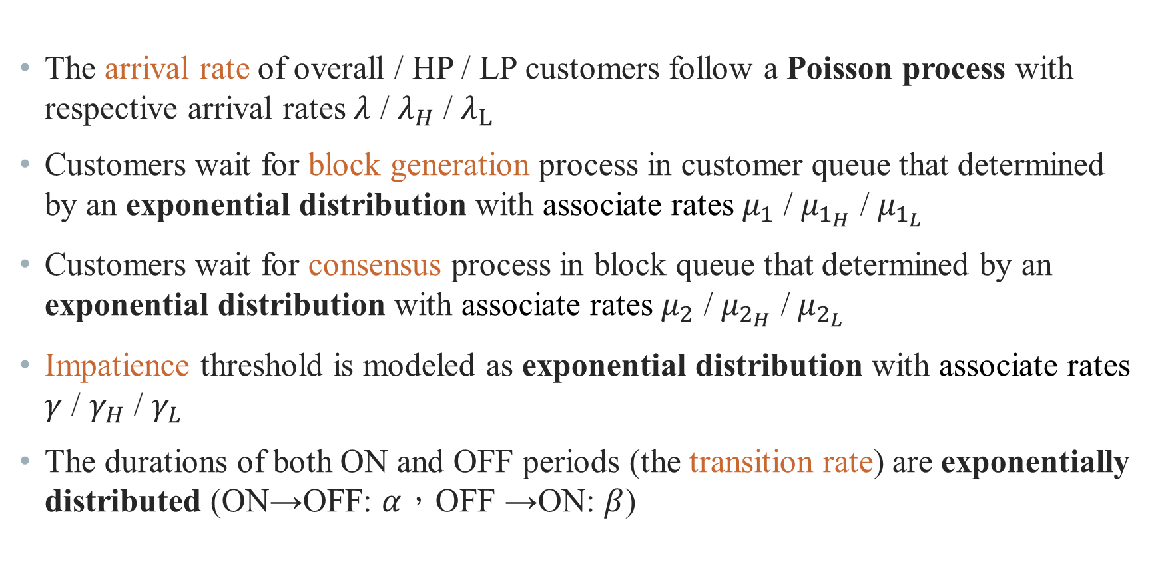
Analytical Model
The arrival rate of overall / HP / LP customers follow a Poisson process with respective arrival rates $λ$ / $λ_{H}$ / $λ_{L}$
Customers wait for block generation process in customer queue that determined by an exponential distribution with associate rates $μ_{1}$ / $μ_{1_{H}}$ / $μ_{1_{L}}$
Customers wait for consensus process in block queue that determined by an exponential distribution with associate rates $μ_{2}$ / $μ_{2_{H}}$ / $μ_{2_{L}}$
Impatience threshold is modeled as exponential distribution with associate rates $γ$ / $γ_{H}$ / $γ_{L}$
The durations of both ON and OFF periods (the transition rate) are exponentially distributed (ON→OFF: $α$，OFF →ON: $β$)
Notes:
顧客的arrival rate是遵循Poisson process，用lambda符號做表示。在有高低優先權的scenario中以$λ$ / $λ_{H}$ / $λ_{L}$分別表示overall，高優先權和低優先權的arrival rate
第2~5點的block generation rate，consensus rate，impatience rate，以及transition rate都是遵循指數分布
block generation rate，consensus rate，impatience rate的速率分別以$μ_{1}、μ_{2}、γ$做表示
Transition rate的部分，$α$表示ON到OFF的速率，$β$表示OFF到ON的速率

Slide 16
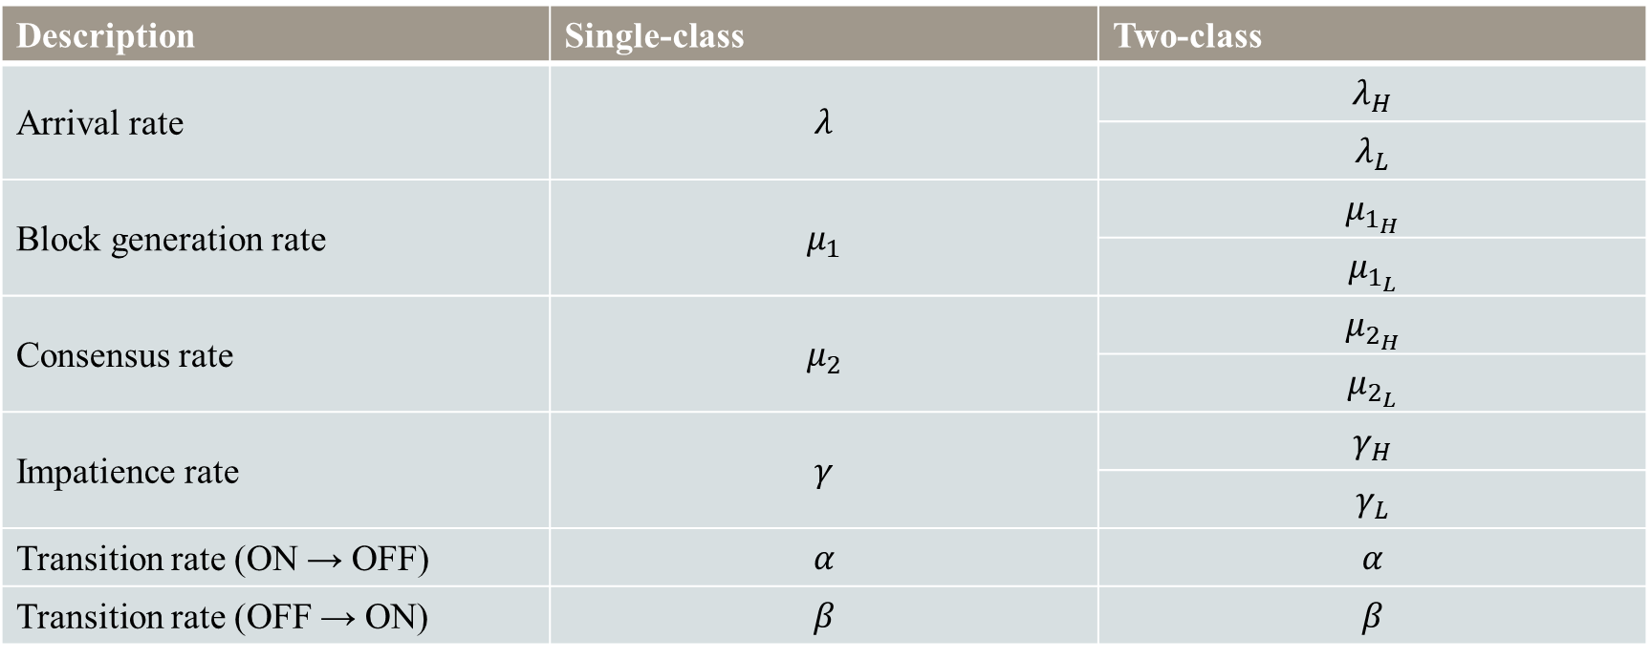
Analytical Model
Description | Single-class | Two-class
Arrival rate | $$λ$$ | $$λ_{H}$$
 |  | $$λ_{L}$$
Block generation rate | $$μ_{1}$$ | $$μ_{1_{H}}$$
 |  | $$μ_{1_{L}}$$
Consensus rate | $$μ_{2}$$ | $$μ_{2_{H}}$$
 |  | $$μ_{2_{L}}$$
Impatience rate | $$γ$$ | $$γ_{H}$$
 |  | $$γ_{L}$$
Transition rate (ON → OFF) | $$α$$ | $$α$$
Transition rate (OFF → ON) | $$β$$ | $$β$$
Notes:
這是綜合前一頁的敘述所製作的參數表可以做參考

Slide 17
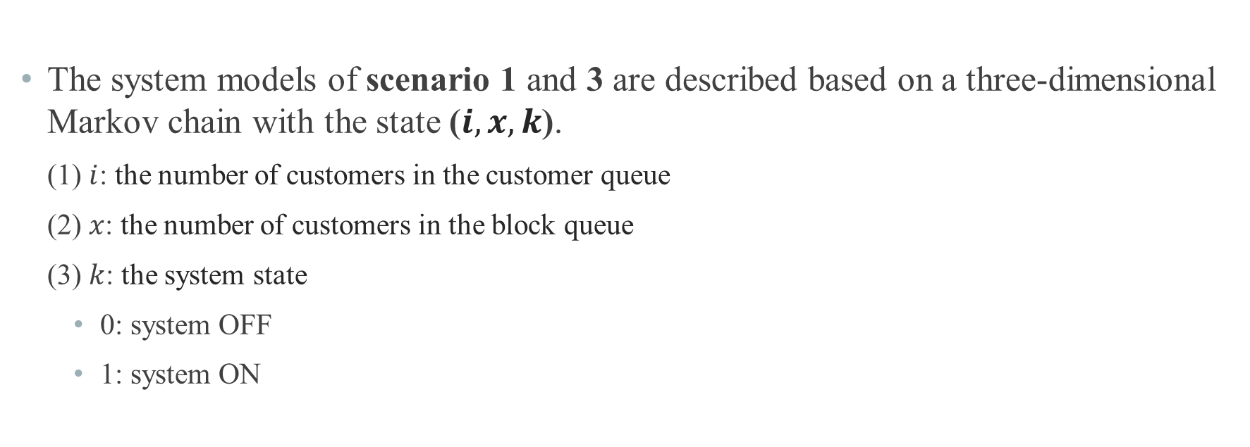
Analytical Model
The system models of scenario 1 and 3 are described based on a three-dimensional Markov chain with the state ($i, x, k$).
(1) $i$: the number of customers in the customer queue
(2) $x$: the number of customers in the block queue
(3) $k$: the system state
0: system OFF
1: system ON
Notes:
我們將scenario 1和scenario 3的各個status的系統狀態模型用三維馬可夫鏈來描述
其中$i$代表
$x$代表
$k$代表

Slide 18
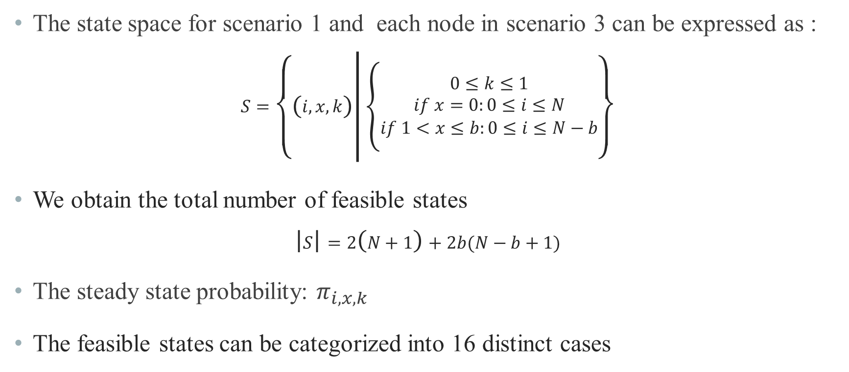
Analytical Model
The state space for scenario 1 and each node in scenario 3 can be expressed as :
$$S=\left\{\left(i, x, k\right) | \left\{\begin{aligned}0≤k≤1 \\ if x=0:0≤i≤N \\ if 1<x≤b:0≤i≤N−b\end{aligned}\right.\right\}$$
We obtain the total number of feasible states
$$\left|S\right|=2\left(N+1\right)+2b(N−b+1)$$
The steady state probability: $π_{i,x,k}$
The feasible states can be categorized into 16 distinct cases

Slide 19
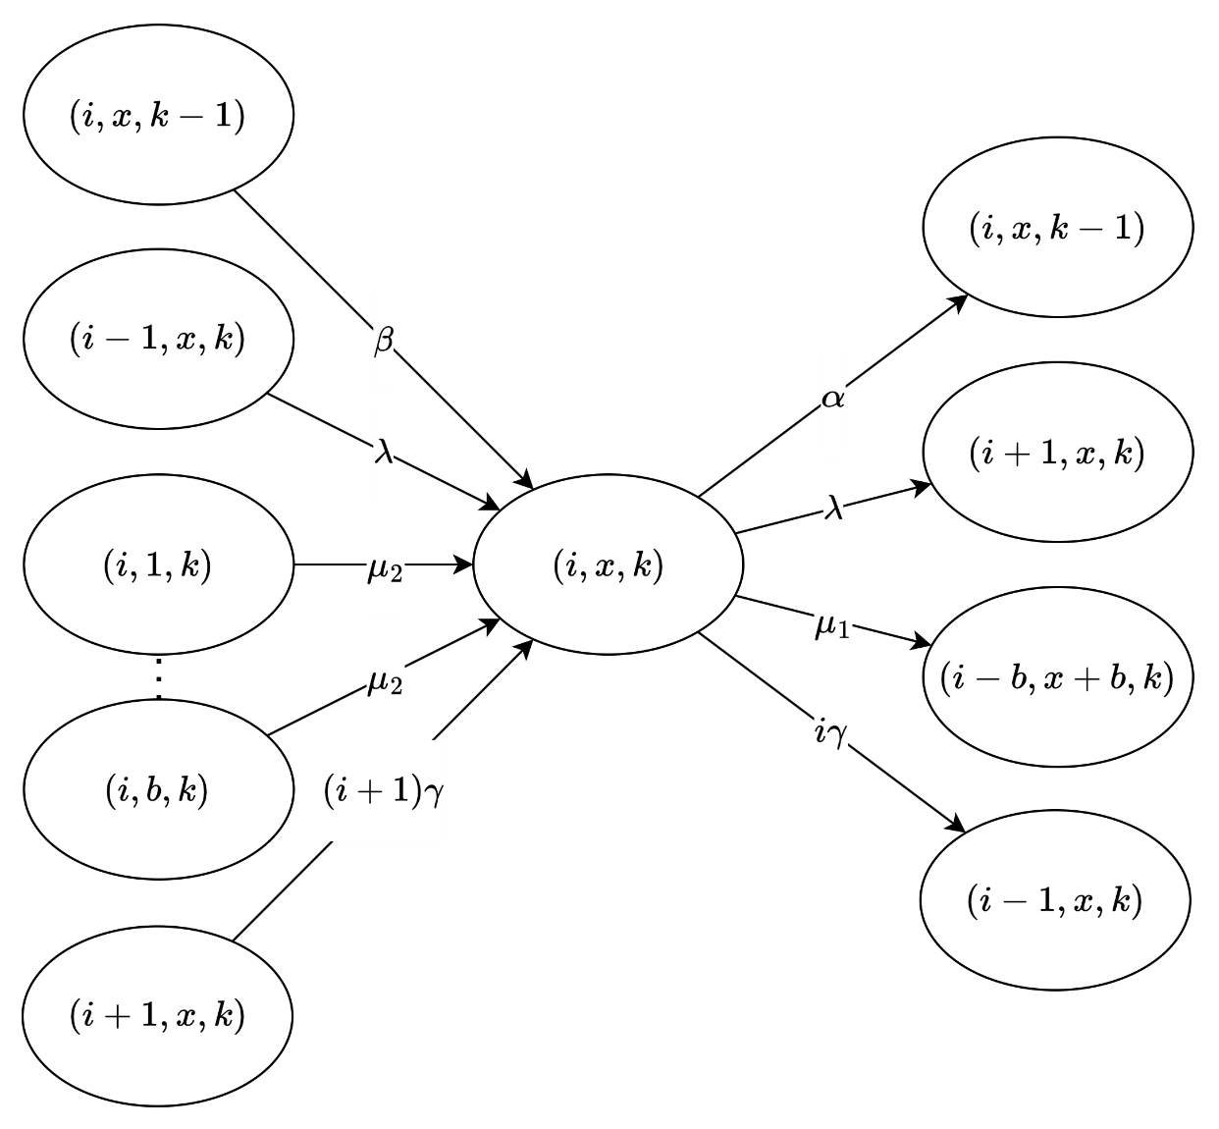
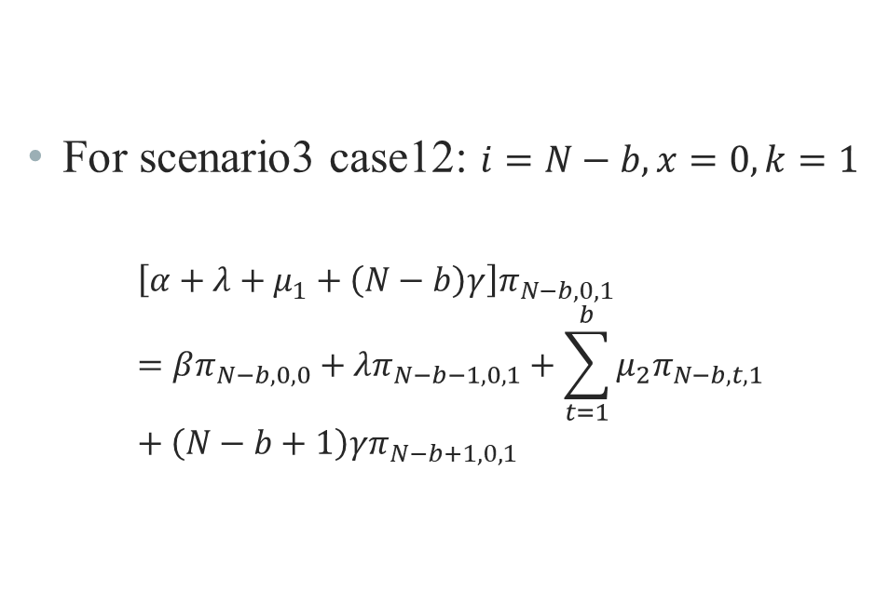
Analytical Model – State Balance Equations
For scenario3 case12: $i=N−b, x=0, k=1$
$$\left[α+λ+μ_{1}+\left(N−b\right)γ\right]π_{N−b,0,1}=βπ_{N−b,0,0}+λπ_{N−b−1,0,1}+\sum_{t=1}^{b}{μ_{2}π_{N−b,t,1}}+\left(N−b+1\right)γπ_{N−b+1,0,1}$$

Slide 20
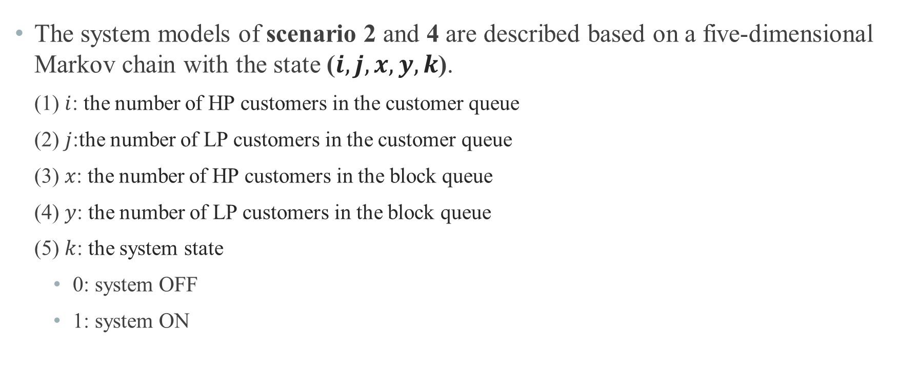
Analytical Model
The system models of scenario 2 and 4 are described based on a five-dimensional Markov chain with the state ($i,j,x, y,k$).
(1) $i$: the number of HP customers in the customer queue
(2) $j$:the number of LP customers in the customer queue
(3) $x$: the number of HP customers in the block queue
(4) $y$: the number of LP customers in the block queue
(5) $k$: the system state
0: system OFF
1: system ON

Slide 21
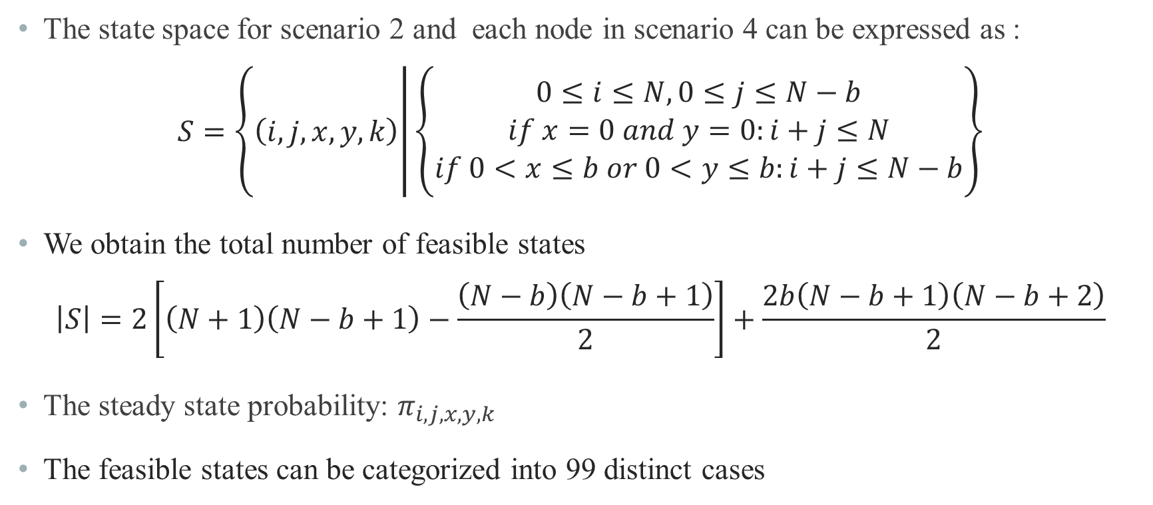
Analytical Model
The state space for scenario 2 and each node in scenario 4 can be expressed as :
$$S=\left\{\left(i,j, x,y, k\right) | \left\{\begin{aligned}0≤i≤N, 0≤j≤N−b \\ if x=0 and y=0:i+j≤N \\ if 0<x≤b or 0<y≤b:i+j≤N−b\end{aligned}\right.\right\}$$
We obtain the total number of feasible states
$$\left|S\right|=2\left[\left(N+1\right)\left(N−b+1\right)−\frac{\left(N−b\right)\left(N−b+1\right)}{2}\right]+\frac{2b\left(N−b+1\right)\left(N−b+2\right)}{2}$$
The steady state probability: $π_{i,j,x,y,k}$
The feasible states can be categorized into 99 distinct cases

Slide 22
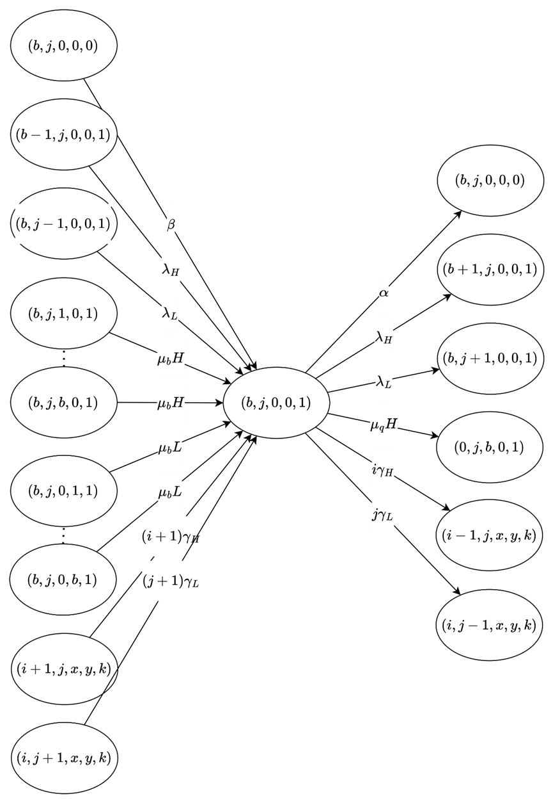
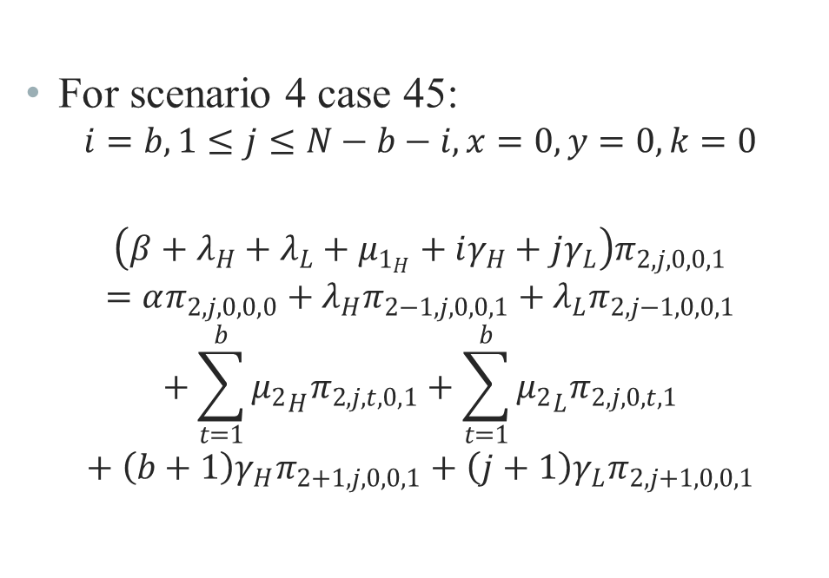
Analytical Model – State Balance Equations
For scenario 4 case 45:
$$i=b,1≤j≤N−b−i,x=0,y=0,k=0$$
$$\left(β+λ_{H}+λ_{L}+μ_{1_{H}}+iγ_{H}+jγ_{L}\right)π_{2,j,0,0,1}=απ_{2,j,0,0,0}+λ_{H}π_{2−1,j,0,0,1}+λ_{L}π_{2,j−1,0,0,1}+\sum_{t=1}^{b}{{μ_{2}}_{H}π_{2,j,t,0,1}}+\sum_{t=1}^{b}{{μ_{2}}_{L}π_{2,j,0,t,1}}+\left(b+1\right)γ_{H}π_{2+1,j,0,0,1}+\left(j+1\right)γ_{L}π_{2,j+1,0,0,1}$$

Slide 23
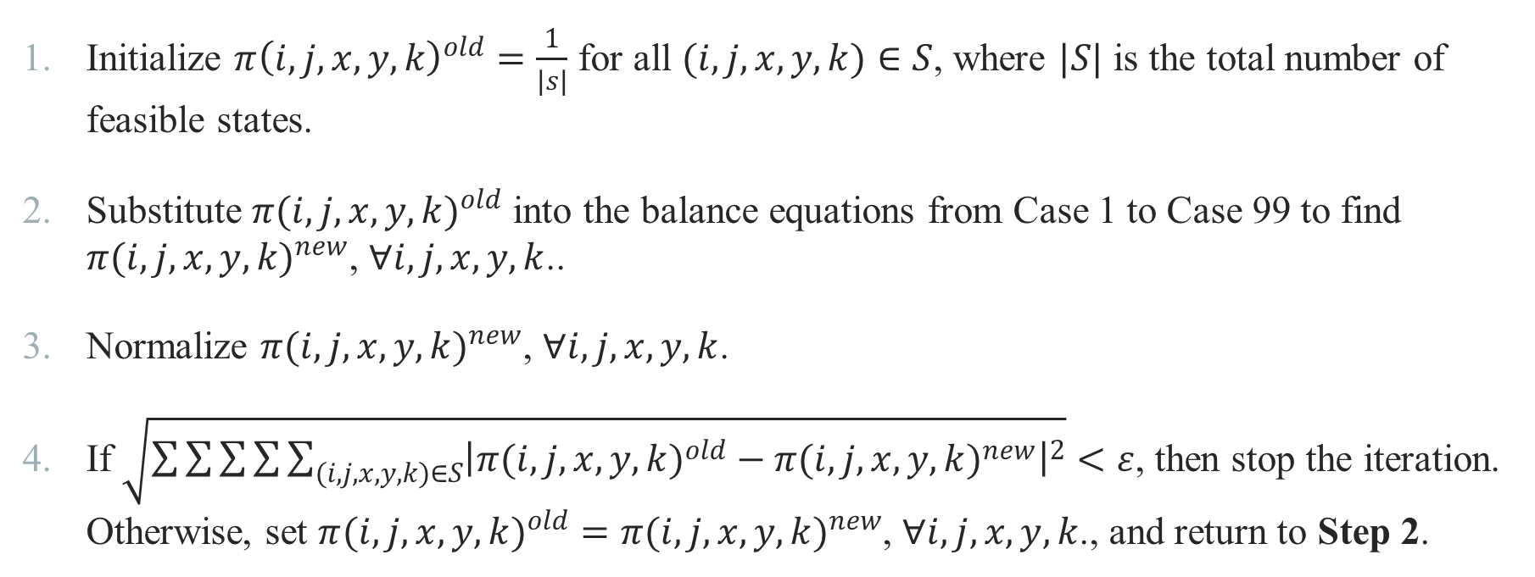
Analytical Model – Iterative Algorism
Initialize $π{\left(i,j,x,y,k\right)}^{old}=\frac{1}{\left|s\right|}$ for all $(i,j,x,y,k)∈S$, where $|S|$ is the total number of feasible states.
Substitute ${π(i,j,x,y,k)}^{old}$ into the balance equations from Case 1 to Case 99 to find ${π(i,j,x,y,k)}^{new}$, $∀i,j,x,y,k$..
Normalize ${π(i,j,x,y,k)}^{new}$, $∀i,j,x,y,k$.
If $\sqrt{\sum{\sum{\sum{\sum{\sum_{(i,j,x,y,k)∈S}{{\left|{π(i,j,x,y,k)}^{old}−{π(i,j,x,y,k)}^{new}\right|}^{2}}}}}}}<ε$, then stop the iteration. Otherwise, set ${π(i,j,x,y,k)}^{old}={π(i,j,x,y,k)}^{new}$, $∀i,j,x,y,k$., and return to Step 2.

Slide 24
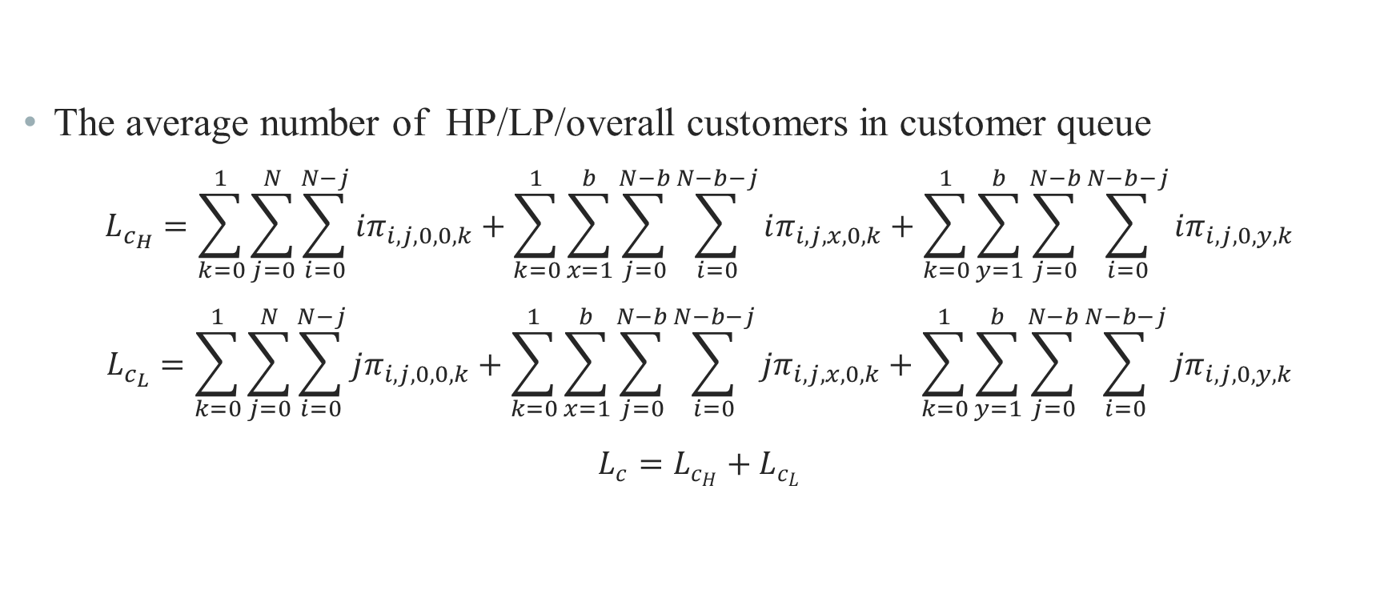
Analytical Model – Performance Measure
The average number of HP/LP/overall customers in customer queue
$$L_{c_{H}}=\sum_{k=0}^{1}{\sum_{j=0}^{N}{\sum_{i=0}^{N−j}{iπ_{i,j,0,0,k}}}}+\sum_{k=0}^{1}{\sum_{x=1}^{b}{\sum_{j=0}^{N−b}{\sum_{i=0}^{N−b−j}{iπ_{i,j,x,0,k}}}}}+\sum_{k=0}^{1}{\sum_{y=1}^{b}{\sum_{j=0}^{N−b}{\sum_{i=0}^{N−b−j}{iπ_{i,j,0,y,k}}}}}$$
$$L_{c_{L}}=\sum_{k=0}^{1}{\sum_{j=0}^{N}{\sum_{i=0}^{N−j}{jπ_{i,j,0,0,k}}}}+\sum_{k=0}^{1}{\sum_{x=1}^{b}{\sum_{j=0}^{N−b}{\sum_{i=0}^{N−b−j}{jπ_{i,j,x,0,k}}}}}+\sum_{k=0}^{1}{\sum_{y=1}^{b}{\sum_{j=0}^{N−b}{\sum_{i=0}^{N−b−j}{jπ_{i,j,0,y,k}}}}}$$
$$L_{c}=L_{c_{H}}+L_{c_{L}}$$

Slide 25
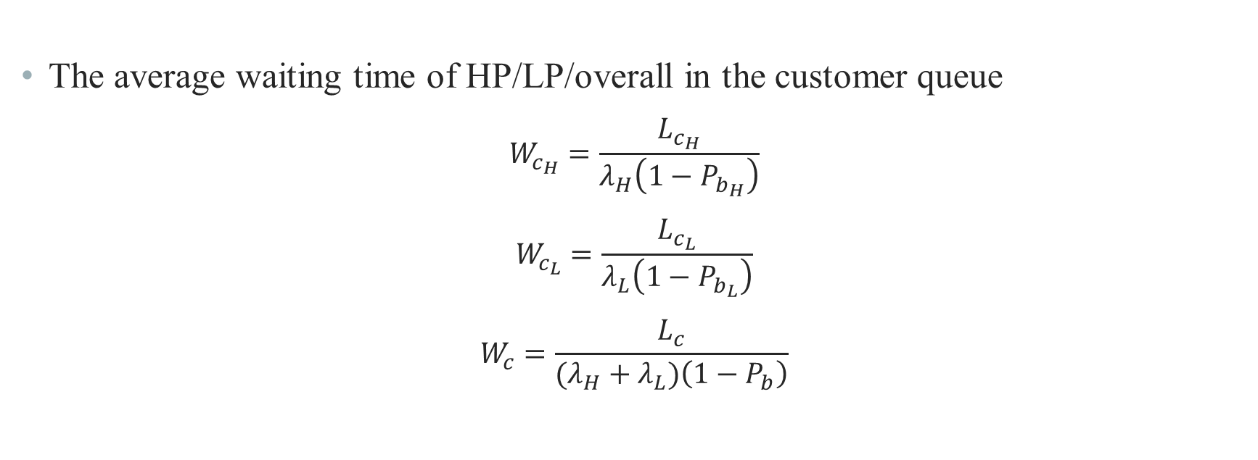
Analytical Model – Performance Measure
The average waiting time of HP/LP/overall in the customer queue
$$W_{c_{H}}=\frac{L_{c_{H}}}{λ_{H}\left(1−P_{b_{H}}\right)}$$
$$W_{c_{L}}=\frac{L_{c_{L}}}{λ_{L}\left(1−P_{b_{L}}\right)}$$
$$W_{c}=\frac{L_{c}}{(λ_{H}+λ_{L})\left(1−P_{b}\right)}$$

Slide 26
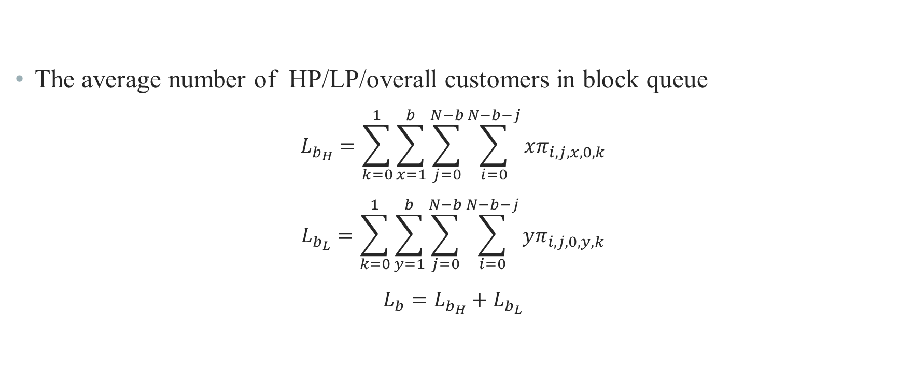
Analytical Model – Performance Measure
The average number of HP/LP/overall customers in block queue
$$L_{b_{H}}=\sum_{k=0}^{1}{\sum_{x=1}^{b}{\sum_{j=0}^{N−b}{\sum_{i=0}^{N−b−j}{xπ_{i,j,x,0,k}}}}}$$
$$L_{b_{L}}=\sum_{k=0}^{1}{\sum_{y=1}^{b}{\sum_{j=0}^{N−b}{\sum_{i=0}^{N−b−j}{yπ_{i,j,0,y,k}}}}}$$
$$L_{b}=L_{b_{H}}+L_{b_{L}}$$

Slide 27
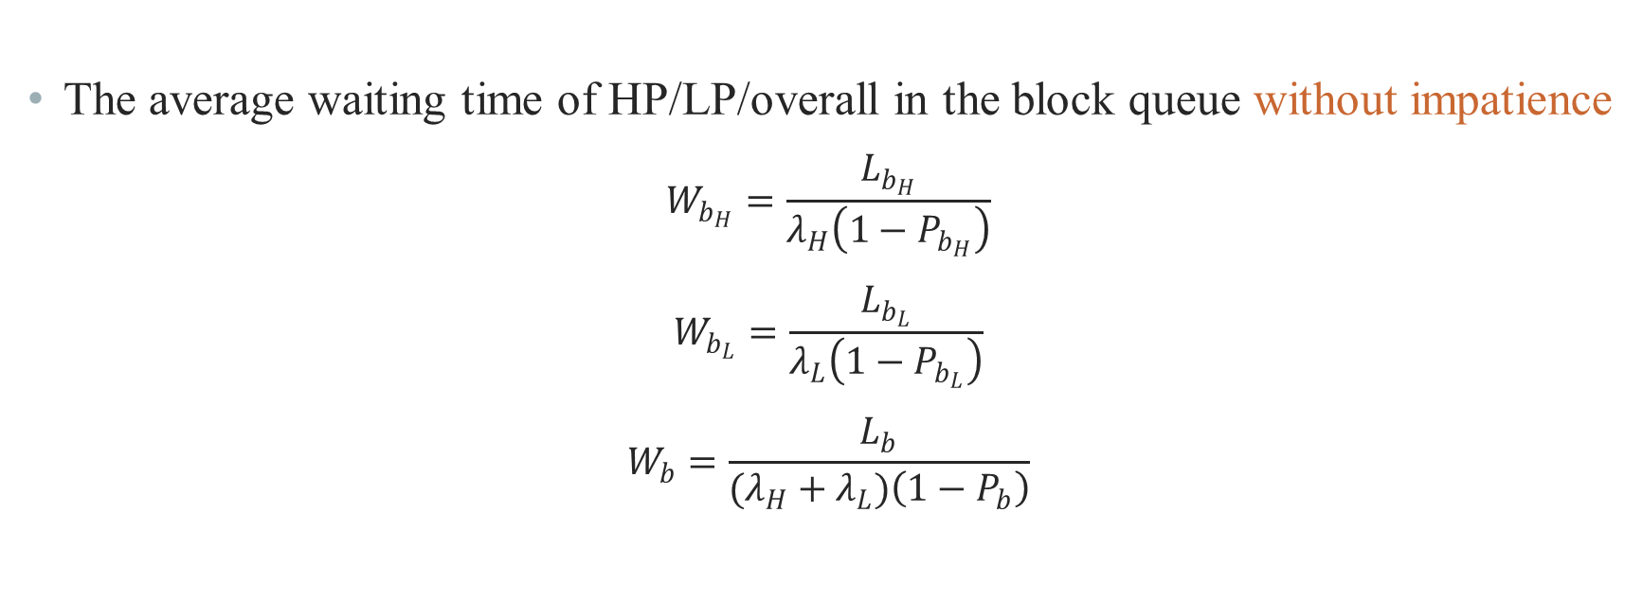
Analytical Model – Performance Measure
The average waiting time of HP/LP/overall in the block queue without impatience
$$W_{b_{H}}=\frac{L_{b_{H}}}{λ_{H}\left(1−P_{b_{H}}\right)}$$
$$W_{b_{L}}=\frac{L_{b_{L}}}{λ_{L}\left(1−P_{b_{L}}\right)}$$
$$W_{b}=\frac{L_{b}}{(λ_{H}+λ_{L})\left(1−P_{b}\right)}$$

Slide 28
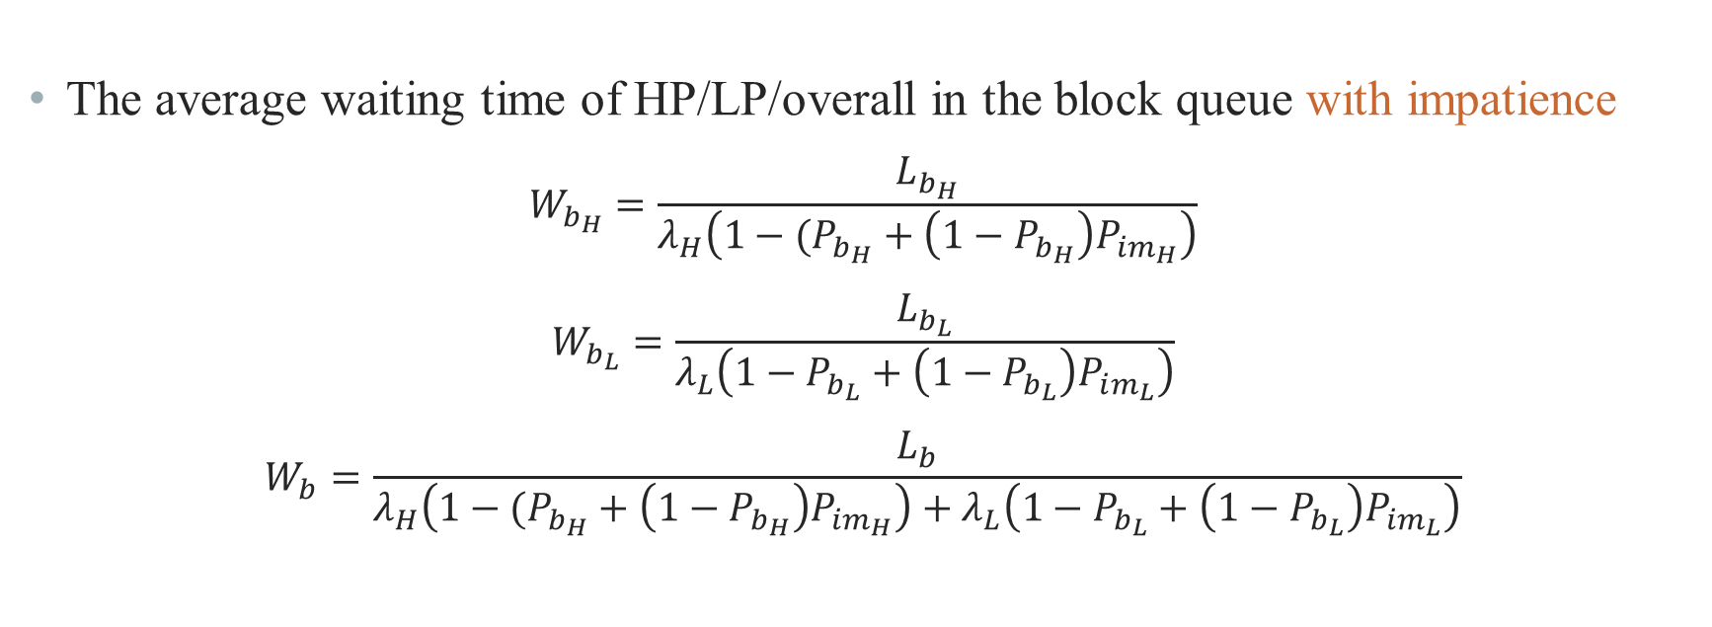
Analytical Model – Performance Measure
The average waiting time of HP/LP/overall in the block queue with impatience
$$W_{b_{H}}=\frac{L_{b_{H}}}{λ_{H}\left(1−(P_{b_{H}}+\left(1−P_{b_{H}}\right)P_{im_{H}}\right)}$$
$$W_{b_{L}}=\frac{L_{b_{L}}}{λ_{L}\left(1−P_{b_{L}}+\left(1−P_{b_{L}}\right)P_{im_{L}}\right)}$$
$$W_{b}=\frac{L_{b}}{λ_{H}\left(1−(P_{b_{H}}+\left(1−P_{b_{H}}\right)P_{im_{H}}\right)+λ_{L}\left(1−P_{b_{L}}+\left(1−P_{b_{L}}\right)P_{im_{L}}\right)}$$

Slide 29
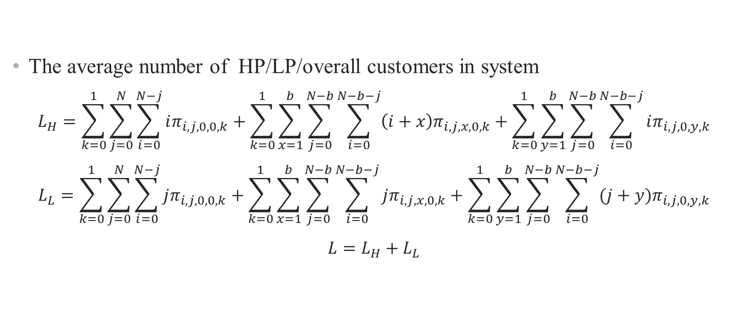
Analytical Model – Performance Measure
The average number of HP/LP/overall customers in system
$$L_{H}=\sum_{k=0}^{1}{\sum_{j=0}^{N}{\sum_{i=0}^{N−j}{iπ_{i,j,0,0,k}}}}+\sum_{k=0}^{1}{\sum_{x=1}^{b}{\sum_{j=0}^{N−b}{\sum_{i=0}^{N−b−j}{\left(i+x\right)π_{i,j,x,0,k}}}}}+\sum_{k=0}^{1}{\sum_{y=1}^{b}{\sum_{j=0}^{N−b}{\sum_{i=0}^{N−b−j}{iπ_{i,j,0,y,k}}}}}$$
$$L_{L}=\sum_{k=0}^{1}{\sum_{j=0}^{N}{\sum_{i=0}^{N−j}{jπ_{i,j,0,0,k}}}}+\sum_{k=0}^{1}{\sum_{x=1}^{b}{\sum_{j=0}^{N−b}{\sum_{i=0}^{N−b−j}{jπ_{i,j,x,0,k}}}}}+\sum_{k=0}^{1}{\sum_{y=1}^{b}{\sum_{j=0}^{N−b}{\sum_{i=0}^{N−b−j}{(j+y)π_{i,j,0,y,k}}}}}$$
$$L=L_{H}+L_{L}$$

Slide 30
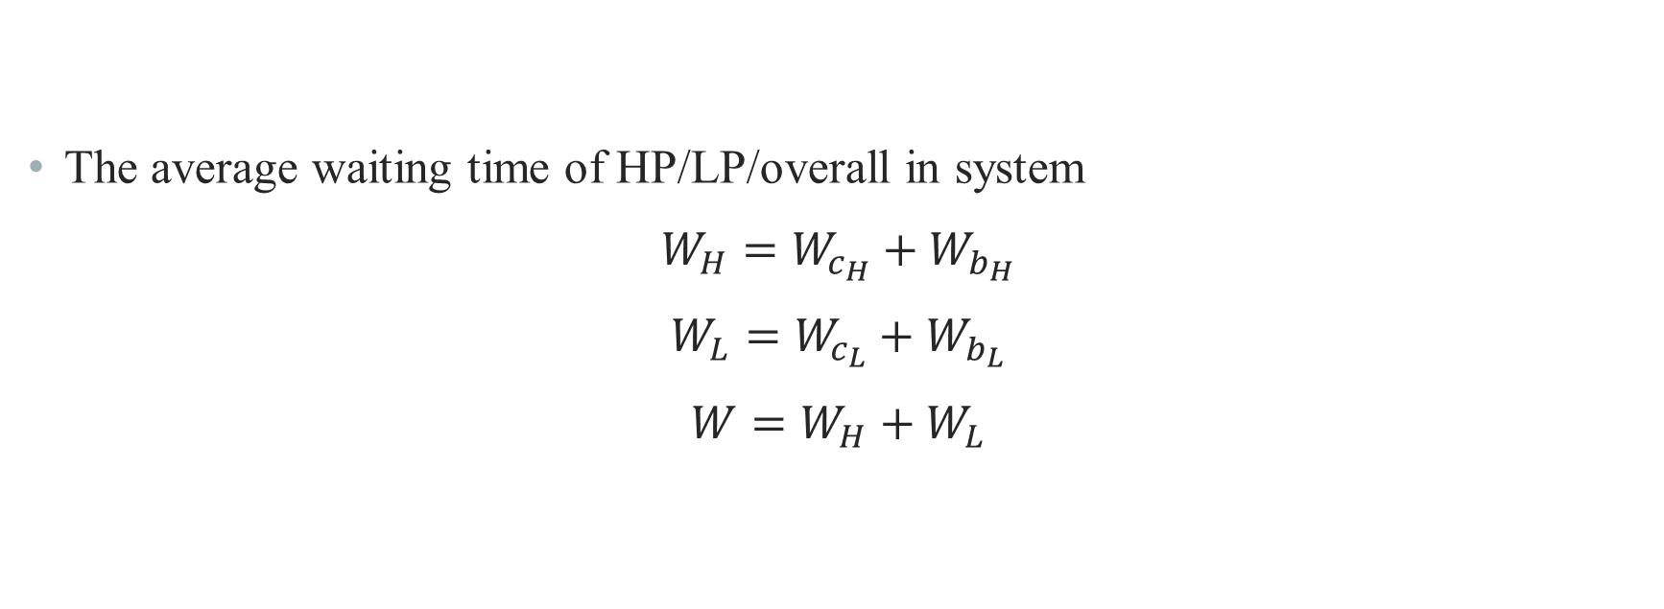
Analytical Model – Performance Measure
The average waiting time of HP/LP/overall in system
$$W_{H}=W_{c_{H}}+W_{b_{H}}$$
$$W_{L}=W_{c_{L}}+W_{b_{L}}$$
$$W=W_{H}+W_{L}$$

Slide 31
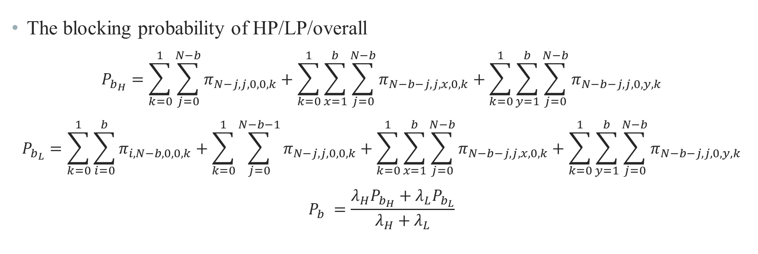
Analytical Model – Performance Measure
The blocking probability of HP/LP/overall
$$P_{b_{H}}=\sum_{k=0}^{1}{\sum_{j=0}^{N−b}{π_{N−j,j,0,0,k}}}+\sum_{k=0}^{1}{\sum_{x=1}^{b}{\sum_{j=0}^{N−b}{π_{N−b−j,j,x,0,k}}}}+\sum_{k=0}^{1}{\sum_{y=1}^{b}{\sum_{j=0}^{N−b}{π_{N−b−j,j,0,y,k}}}}$$
$$P_{b_{L}}=\sum_{k=0}^{1}{\sum_{i=0}^{b}{π_{i,N−b,0,0,k}}}+\sum_{k=0}^{1}{\sum_{j=0}^{N−b−1}{π_{N−j,j,0,0,k}}}+\sum_{k=0}^{1}{\sum_{x=1}^{b}{\sum_{j=0}^{N−b}{π_{N−b−j,j,x,0,k}}}}+\sum_{k=0}^{1}{\sum_{y=1}^{b}{\sum_{j=0}^{N−b}{π_{N−b−j,j,0,y,k}}}}$$
$$P_{b} =\frac{λ_{H}P_{b_{H}}+λ_{L}P_{b_{L}}}{λ_{H}+λ_{L}}$$

Slide 32
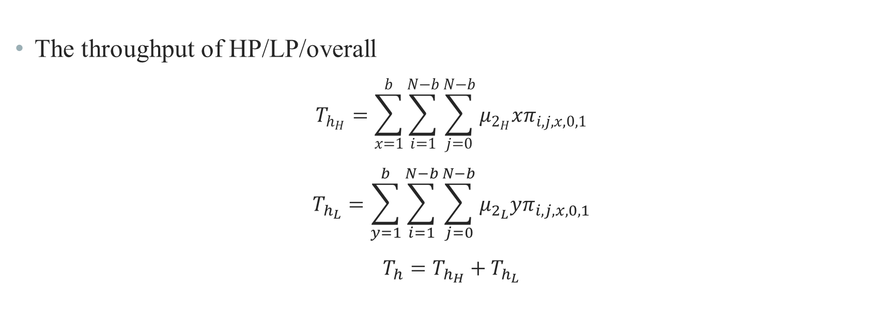
Analytical Model – Performance Measure
The throughput of HP/LP/overall
$$T_{h_{H}}=\sum_{x=1}^{b}{\sum_{i=1}^{N−b}{\sum_{j=0}^{N−b}{μ_{2_{H}}xπ_{i,j,x,0,1}}}}$$
$$T_{h_{L}}=\sum_{y=1}^{b}{\sum_{i=1}^{N−b}{\sum_{j=0}^{N−b}{μ_{2_{L}}yπ_{i,j,x,0,1}}}}$$
$$T_{h}=T_{h_{H}}+T_{h_{L}}$$

Slide 33
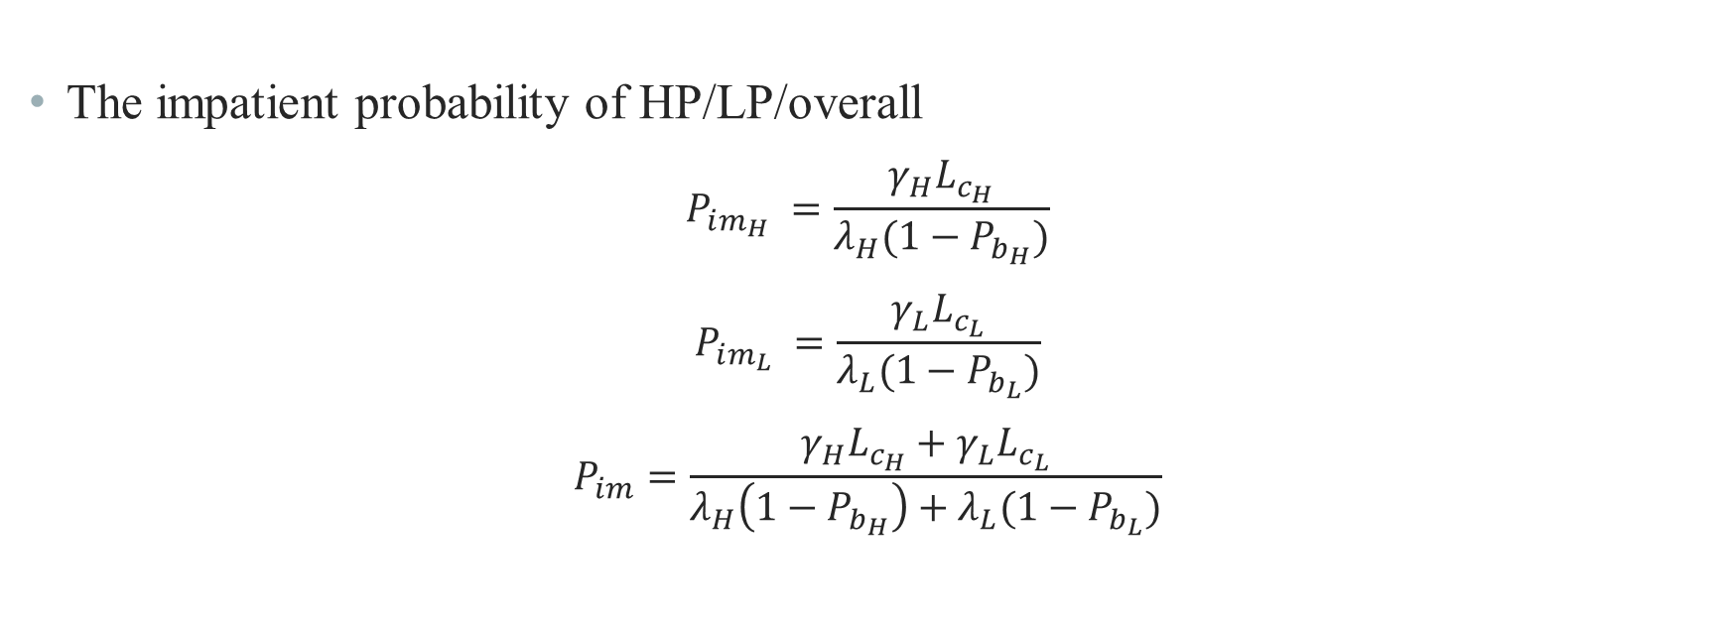
Analytical Model – Performance Measure
The impatient probability of HP/LP/overall
$$P_{im_{H}} =\frac{γ_{H}L_{c_{H}}}{λ_{H}(1−P_{b_{H}})}$$
$$P_{im_{L}} =\frac{γ_{L}L_{c_{L}}}{λ_{L}(1−P_{b_{L}})}$$
$$P_{im}=\frac{{γ_{H}L_{c_{H}}+γ}_{L}L_{c_{L}}}{λ_{H}\left(1−P_{b_{H}}\right)+λ_{L}(1−P_{b_{L}})}$$

Slide 34
Outline
Motivation
System Model
Analytical Model
Numerical Results
Conclusions and Future Works
Notes:
數值結果

Slide 35
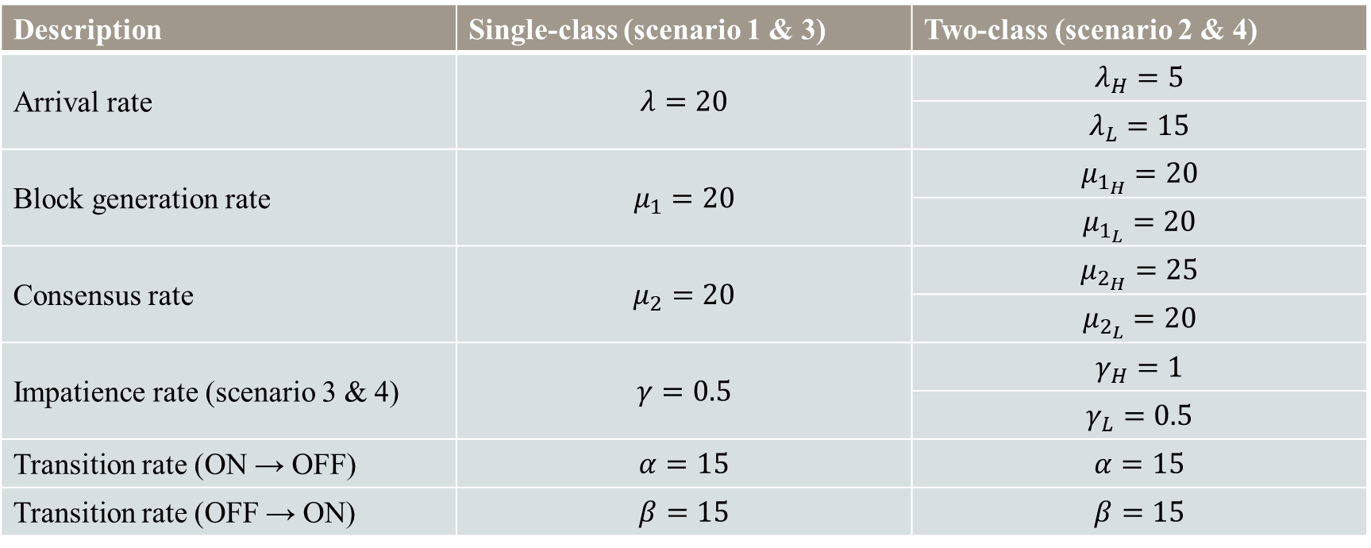
Numerical Result
Description | Single-class (scenario 1 & 3) | Two-class (scenario 2 & 4)
Arrival rate | $$λ=20$$ | $$λ_{H}=5$$
 |  | $$λ_{L}=15$$
Block generation rate | $$μ_{1}=20$$ | $$μ_{1_{H}}=20$$
 |  | $$μ_{1_{L}}=20$$
Consensus rate | $$μ_{2}=20$$ | $$μ_{2_{H}}=25$$
 |  | $$μ_{2_{L}}=20$$
Impatience rate (scenario 3 & 4) | $$γ=0.5$$ | $$γ_{H}=1$$
 |  | $$γ_{L}=0.5$$
Transition rate (ON → OFF) | $$α=15$$ | $$α=15$$
Transition rate (OFF → ON) | $$β=15$$ | $$β=15$$
$N=20$, $b=5$ for all scenarios

Slide 36
Numerical Result – scenario 1 vs 3

Slide 37
Numerical Result – scenario 1 vs 3

Slide 38
Numerical Result – scenario 1 vs 3

Slide 39
Numerical Result – scenario 2 vs 4

Slide 40
Numerical Result – scenario 2 vs 4

Slide 41
Numerical Result – scenario 2 vs 4

Slide 42
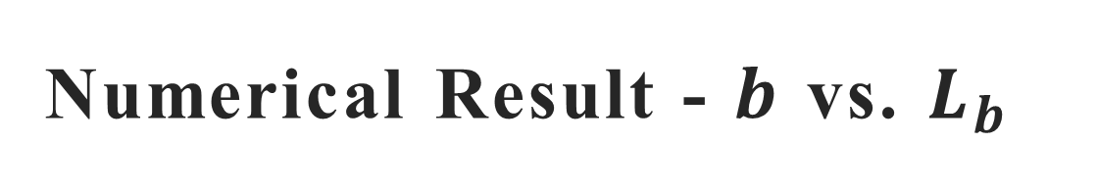
Numerical Result - $b$ vs. $L_{b}$

Slide 43
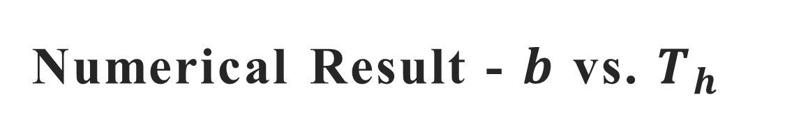
Numerical Result - $b$ vs. $T_{h}$

Slide 44
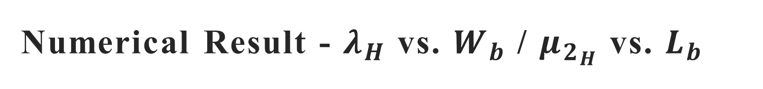
Numerical Result - $λ_{H}$ vs. $W_{b}$ / $μ_{2_{H}}$ vs. $L_{b}$

Slide 45
Outline
Motivation
System Model
Analytical Model
Numerical Results
Conclusions and Future Works
Notes:
結論 未來展望

Slide 46
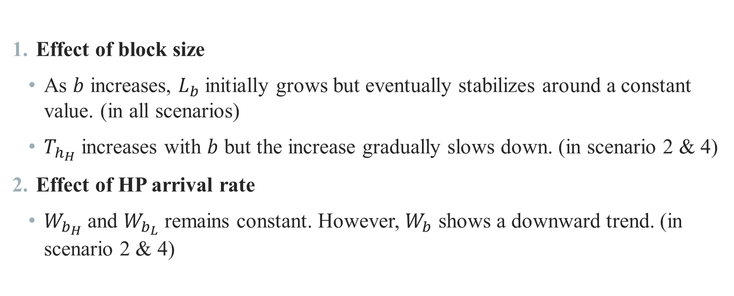
Conclusion
Effect of block size
As $b$ increases, $L_{b}$ initially grows but eventually stabilizes around a constant value. (in all scenarios)
$T_{h_{H}}$ increases with $b$ but the increase gradually slows down. (in scenario 2 & 4)
Effect of HP arrival rate
$W_{b_{H}}$ and $W_{b_{L}}$ remains constant. However, $W_{b}$ shows a downward trend. (in scenario 2 & 4)

Slide 47
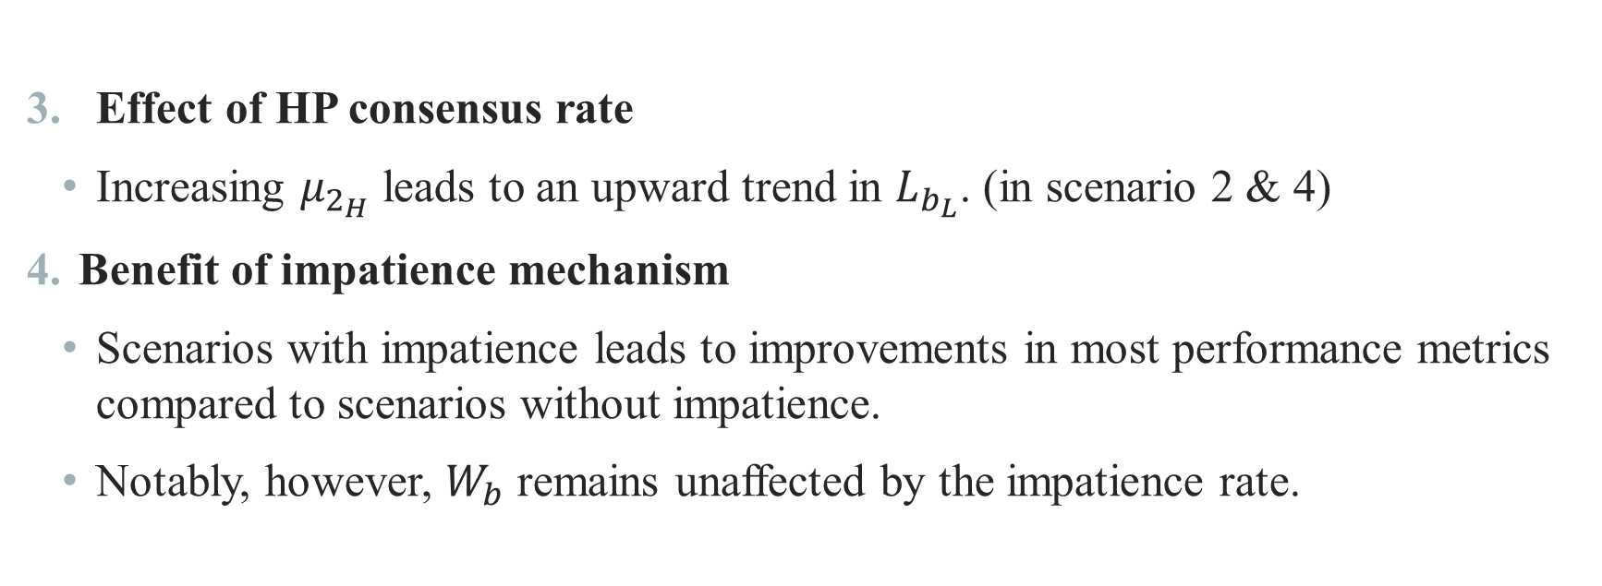
Conclusion
Effect of HP consensus rate
Increasing $μ_{2_{H}}$ leads to an upward trend in $L_{b_{L}}$. (in scenario 2 & 4)
Benefit of impatience mechanism
Scenarios with impatience leads to improvements in most performance metrics compared to scenarios without impatience.
Notably, however, $W_{b}$ remains unaffected by the impatience rate.

Slide 48
Future Work
Incorporate realistic voting mechanisms
Integrate more practical consensus voting procedures to reflect actual blockchain operations.
Dynamic batch policy optimization
Adapt the batch size based on the real-time state of the customer and block queues.
Enhanced impatience modeling
Extend impatience behavior to account for total time until departure, including both waiting and consensus delays.

Slide 49
Thank you for listening

